Slide 1

IOT BASED AUTOMATIC PET FEEDING SYSTEM Guided by Presented by
T.VIKAS REDDY
P.VANDANA
CH.SATHISH
Dr.G.Uganya

Slide 2
ABSTRACT
Over half of the people in the world intentionally have pets as their companions, But these pets are becoming burden to the pet owners. There is a lot of stress for the owner while feeding their pets. In this project we are building an Arduino based Automatic Pet Feeder which can automatically serve food to your pet timely. It has a DS3231 RTC (Real Time Clock) Module, which used to set time and date on which your pet should be given food and a keypad interface is employed to enable users to set feeding intervals and portion sizes easily. So, by setting up the time according to your pet’s eating schedule, the device drop or fill the food bowl automatically. By this project we can feed the pet when the owner is not available at home.

Slide 3
OBJECTIVE
The objective of this project is to create an automatic feeding machine for pets feeding. This project is designed keeping the view of pets at home it is important to maintain the diet of animals just like human being from keeping them healthy.
When user is at home, it can be controlled by a mobile application through internet. If user is not at home, user can set the timer to feed their pet. To make sure that the food does not exceed force sensor will active and detect the exact amount should be in the bowl.

Slide 4
INTRODUCTION
Automatic pet feeder is one of the new technologies for feeding pet. It will help pet owner to take care of their pet while they are not at home.
Automatic pet feeder is built to help pet owner taking care of their pet. IoT pet feeder is one of the pet feeders that will be controlled by a mobile application through internet.
The automatic pet feeder will automatically dispense predetermined amount of food and water to the bowls.

Slide 5
LITERATURE SURVEY
S no | Title | Author Details | Published year | Inference
1. | Smart Pet Feeder Based on IoT | F.M. Al-Shatti, A. Al-Hamad | 2018 | This study presents a smart pet feeder system utilizing IoT technology to automate the pet feeding process. The system includes features such as scheduling and monitoring pet feeding remotely.
2. | IoT Based Pet Feeding System with Weight Sensor | Pranjal Jain, Dr. M. Balaganesh | 2019 | This project introduces an IoT-based pet feeding system integrated with a weight sensor to ensure accurate portion control.
3. | Automatic Pet Feeding System Using IoT | Shreya Das, Prasenjit Dey | 2020 | This research proposes an automatic pet feeding system employing IoT technology to dispense food based on predefined schedules set by the pet owner
4. | IoT Based Automatic Pet Feeding System with Health Monitoring | S. Priya, Dr. P. Dinesh | 2021 | This project presents an IoT-based automatic pet feeding system integrated with health monitoring functionalities. It allows pet owners to track their pet's health parameters along with feeding schedules.

Slide 6
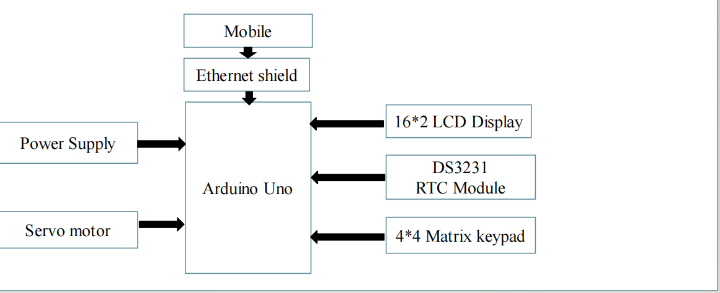
BLOCK DIAGRAM

Slide 7
Methodology
Designing an automatic pet feeding system using Arduino, RTC module, servo motor, LCD, and keypad involves a systematic approach. The system's architecture typically comprises an Arduino microcontroller as the brain, an RTC module for timekeeping accuracy, a servo motor to dispense food, an LCD display for user interaction, and a keypad for input. The hardware is interconnected according to a circuit diagram, ensuring proper power distribution and signal communication. Programming plays a crucial role, with code structured to initialize components, read input from the keypad, display information on the LCD, track time through the RTC module, and control the servo motor's operation. Thorough testing is essential at each stage to verify individual component functionality and overall system integration. The user interface design is critical, requiring a clear and intuitive layout on the LCD screen for setting feeding schedules and portion sizes. Enclosure design is also considered, ensuring durability and accessibility while protecting the system's components. Through meticulous planning, testing, and refinement, the automatic pet feeding system can be developed into a reliable and user-friendly solution for pet owners.

Slide 8
Hardware/Software Used
Hardware:
1. Arduino UNO
2. 4*4 Matirx Keypad
3. 16*2 LCD
4. Push button
5. Servo Motor
6. Resistor
7. Connecting wires
Software:
1. Arduino IDE
2. DS3231 RTC Module Library
3. 4*4 Matrix keypad library

Slide 9
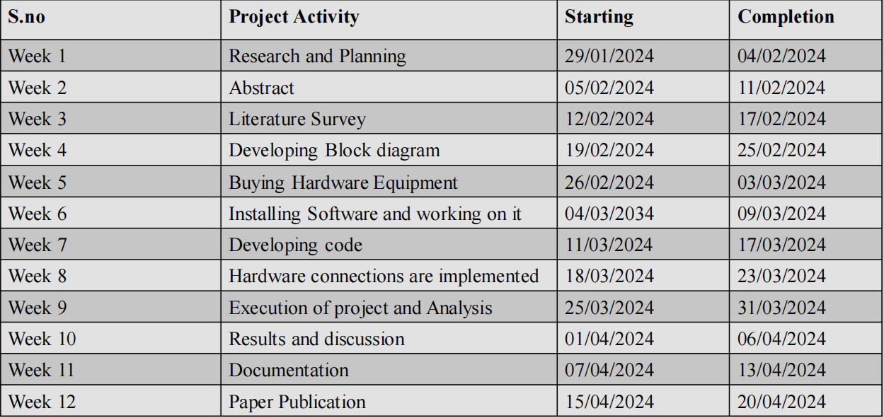
Timeline Plan

Slide 10
References
M. Rohs and B. Gfeller, “Using Camera-Equipped Mo-bile Phones for Interacting with Real-World Object,” Proceedings of Advances in Pervasive Computing, April 2004, pp. 265-271.
C. Sammarco and A. Lera, “Improving Service Management in the Internet of Things,” Sensors, Vol. 12, No. 9, 2012,pp. 11888-11909. doi:10.3390/s120911888.
[6] I. F. Akyildiz W. Su, Y. Sankar Subramaniam and E. Cayirci, “Wireless Sensor Networks: A Survey,” Computer Networks, Vol. 38, No. 4, 2002, pp. 393-422. doi:10.1016/S1389-1286(01)00302-4.

Slide 11
Thank you

